Slide 1
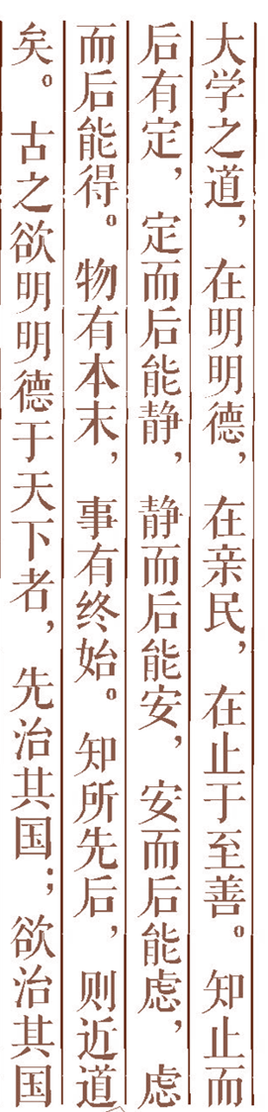
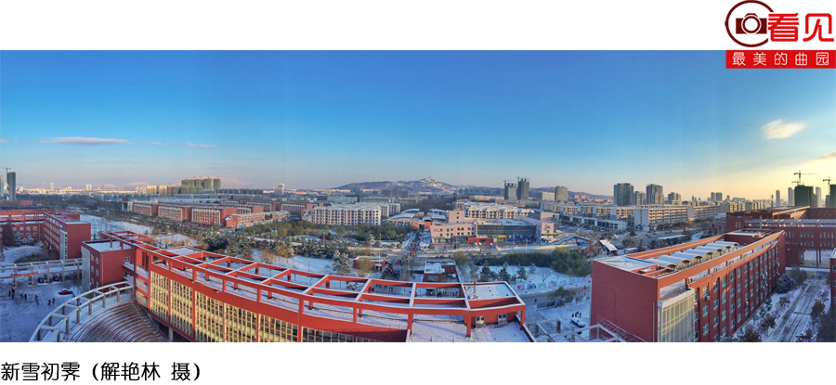

Artificial Intelligence Chapter 19 Formal Concept Analysis: The Important Foundation of Knowledge Interconnection

Slide 2


1.Introduction
2.Semantic interconnection
3.Structure interconnection
4.Statement interconnection
5.Discussion
Outline

Slide 3
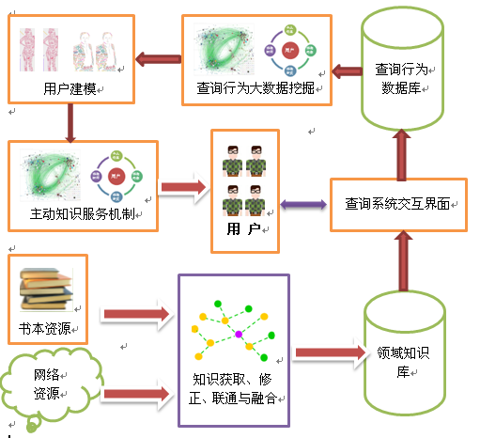

Slide 4
Knowledge interconnection plays a very important role in many knowledge systems, which bridges among knowledge to allow the inference or reasoning to pass through it.

Slide 5
1.Introduction(1/1)
Knowledge interconnection
Concept interconnection
Statement interconnection
Semantic Ones
Structure Ones
Attribute Ones
Relation Ones
Concept
Graph
Attribute Analysis
Relation Analysis
Formal Concept Analysis

Slide 6
2 Semantic Ones
2.1 Relation interconnection
--relation analysis
--part-whole relation
2.2 Attribute interconnection

Slide 7
2.1 Relation interconnection(1/6)
Question: If C1R1C2, C2R2C3, then C1 ? C3?
…… ……
…… ……

Slide 8
2.1 Relation interconnection(2/6)
 | Property | Definition
r | Reflexive | xRx for all x∈S
i | Irreflexive | ¬ xRx for all x∈S
s | Symmetric | xRy→ yRx for all x,y∈S
as | Asymmetric | xRy→ ¬ yRx for all x,y∈S
an | Antisymmetric | xRy ∧ yRx → x=y for all x,y∈S
t | Transitive | xRy ∧ yRz → xRz for all x,y,z∈S
nt | Negatively transitive | ¬xRy∧¬yRz →¬xRz for all x,y,z∈S
c | Connex | xRy or yRx for all x≠y∈S
sc | Strictly connex | xRy or yRx for all x,y∈S

Slide 9
2. 1 Relation interconnection(3/6)
1 | strictly connex → reflexive, connex
2 | transitive, connex→negatively transitive
3 | antisymmetric,negatively transitive→ transitive
4 | asymmetric→ irreflexive,antisymmetric
5 | Symmetric,connex → negatively transitive
6 | Symmetric, antisymmetric → transitive
7 | Irreflexive, antisymmetric → asymmetric
8 | Reflexive,irreflexive → all properties
Implications among properties of relations

Slide 10
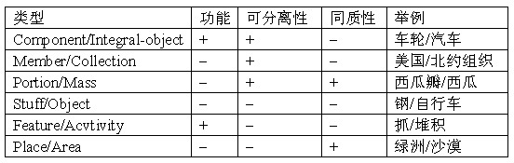
Winston, Chaffin和Herrmann(WCH)等根据功能、可分离性和同质性将部分关系区分为Component/Integral-object, Member/Collection, Place/Area和Feature/Activity等六类
2. 1 Relation interconnection(4/6)

Slide 11
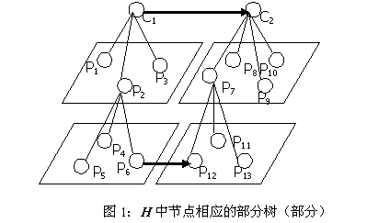
2.1 Relation interconnection(5/6)

Slide 12
2.1 Relation interconnection(6/6)
(1) Whether the parts of artifact inherit the corresponding attributes of the whole;
(2) Whether the attributes of parts inherit the corresponding values over common attributes of the whole;
(3) Whether the whole artifact inherits attributes of the parts;
(4) Whether the attributes of the whole inherit the corresponding values over common attributes of parts;
(5) Intrinsic constraint relations between the attribute values of parts and that of the whole;
(6) Intrinsic constraint relations among the attributes of the same part. e.g. W=Vρ .
一段1 米长的密度为x 的均匀红色细绳平均分成两段0.5米长的绳子。问部分和整体的诸如长度、密度、颜色和重量等属性的属性值之间的关系是什么？

Slide 13
2. 2 Attribute interconnection
2.2.1 Some important definitions in FCA
--Formal context, formal concept
-- many-valued context
2.2.2 Attribute interconnection
--Definition
--Attribute analysis

Slide 14
属性分类
（结构属性）：称a是结构属性,若Val(a)上有某个结构.
（分类型属性）：如果Val(a)是H中的子集,则称a是分类型属性.例如职业.
（非结构属性）：若a的取值域Val(a)是无结构的,则称a是非结构型属性.例如颜色

Slide 15
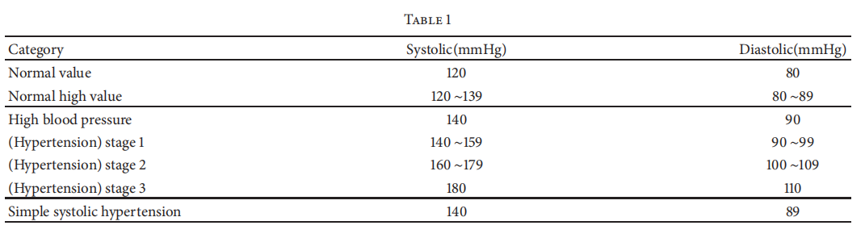
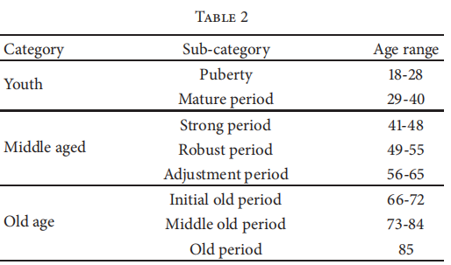
Attribute analysis

Slide 16
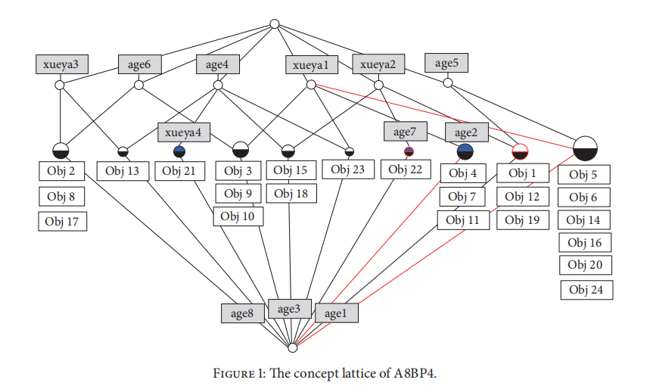

Slide 17
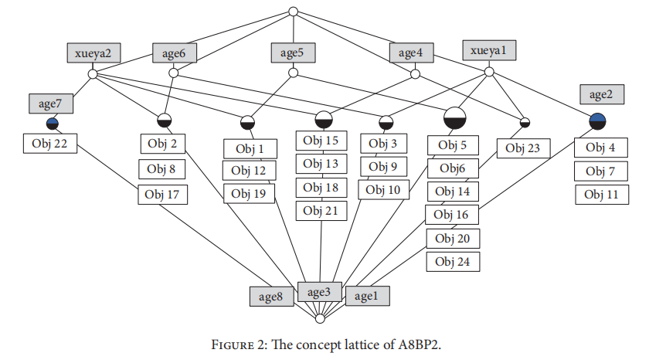

Slide 18
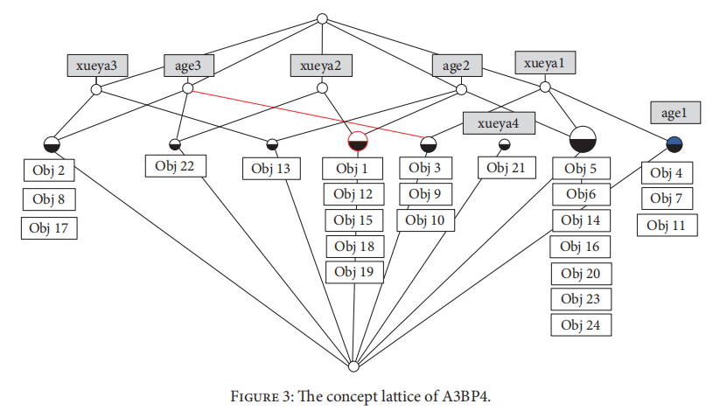

Slide 19
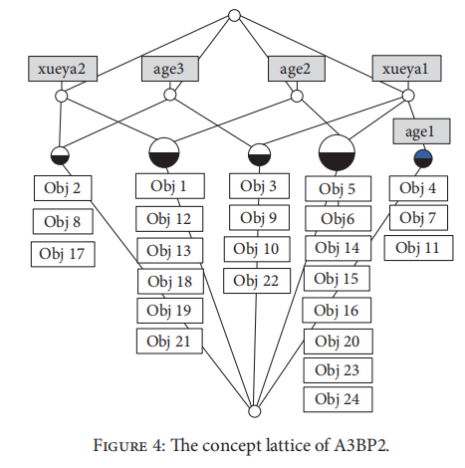

Slide 20
2.2.1 Some definitions of FCA
Definition1: Formal Context K = (G, M, I):
A formal context K = (G, M, I) consists of two sets G, M and I a relation between G and M. The elements of G are called objects, the elements of M are called attributes, gIm it is read : g has m.

Slide 21
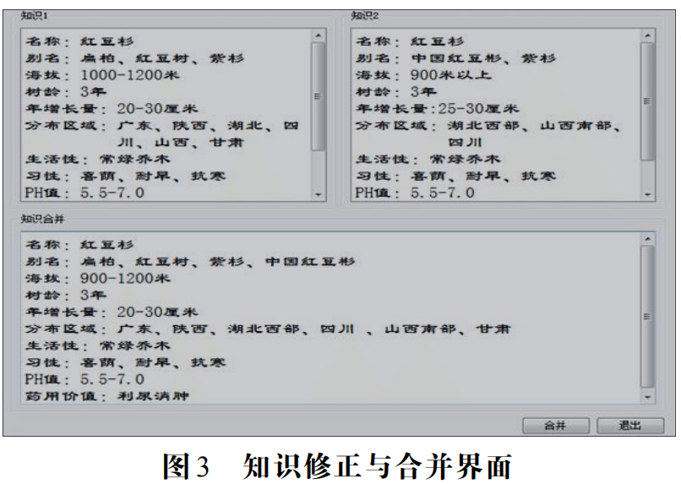
Frames ---contexts

Slide 22
Definition2: Formal Concept :
(A,B) is a formal concept A = B’ and A’ = B
Where: A’ = {m in M| gIm for all g in A} ⊆ G
B’ = {g in G| gIm for all m in B} ⊆ M

Slide 23
Definition3: a many-valued context (G, M, {Val(a)|a∈V},I) consists of sets G,M and {Val(a)|a∈V} and a ternary relation I between G,M and {Val(a)|a∈V}(i.e. I ⊆ G×M×{Val(a)|a∈V}),
where: G is a not empty set whose elements are called objects; M is a set whose elements are called attributes; for each a∈V, Val(a) is a set with elements called values of attribute a;
(x, a, m)∈I meaning that “the attribute a has the value m for the object x.”

Slide 24
Properties
1) A₁ ⊆ A₂ then A₂’ ⊆ A₁’
2) A ⊆ A’’
3) A’ = A’’’
4) A ⊆ B’ iff B ⊆ A’ iff AxB ⊆ I
5) (U A_{t})’ = ∩A’_{t}
6) The set of concepts is a complete lattice.
7) Inf(A_{t}, B_{t}) = (∩A_{t} , (UB_{t})’’)
Sup(A_{t},B_{t}) = ((UA_{t})’’, (∩B_{t}))

Slide 25
Dependencies between attributes
Definition4: Let (G,M, I ) be a formal context and let A,B ⊆ M. We say that the implication A → B
holds in (G,M, I ) iff every object that has all the attributes from A also has all the attributes from B.

Slide 26
Dependencies between attributes
Definition5: if X,Y are sets of attributes of a complete many-values context (G,M,W,I), then we say that Y is functionally dependent on X if the following holds for every pair of objects g,h
(∀m∈X m(g)=m(h)) ⇒ (∀n∈Y n(g)=n(h))

Slide 27
Dependencies between attributes
Definition6: Let (G,M,W,I) be a complete many-valued context and let ≤_{m} be an order relaiton on the set m(G) of the values of m for every attribute m. If X and Y are sets of attributes ,we call Y ordinally dependent on X if the following holds for each pair of objects g,h:
(∀m∈X m(g) ≤_{m} m(h)) ⇒ (∀n∈Y n(g) ≤_{m} n(h))

Slide 28
Proposition:
In (G,M,W,I) the attribute set Y is functionally dependent on X iff the implication X → Y holds in the context K_{N}. The Y is ordinally dependent on X iff the implication X → Y holds in the context Ko.
Where Kn:=({{g,h}|g,h∈ G, g ≠h},M,I_{N})
I_{N}:={g, h} I_{N} m:⇔ m(g)=m(h);
Ko:=(G×G, M, I_{O} ), I_{O}:=(g, h) I_{O} m:⇔ m(g) ≤_{m} m(h);

Slide 29
2.2.2 Attribute interconnection
Definition 8: If C1(m) and C2(n) have some correlationship, then C1 and C2 is attribute interconnection.

Slide 30
For a many-value context (G, M, {Val(a)|a∈V},I), we define a two-argument function Γ: G×M→2^{{Val(a)|a∈V}}
Γ(x, a)={y∈Val(a)|(∀y∈Val(a)→ (x, a, y) ∈I)}
which assigns to each object x∈G and attribute a∈M a subset Γ(x, a)⊆Val(a).

Slide 31
1.Strong positive object-interconnection: x ≈++ y iff (∀a∈V(Γ(x, a) ∩Γ(y, a)) ≠∅)
2.Weak positive object-interconnection: x ≈-+ y iff (∃a∈V(Γ(x, a) ∩Γ(y, a)) ≠∅)
3.Strong negative object-interconnection: x ≈+- y iff (∀a∈V(Γ^{c} (x, a) ∩Γ^{c} (y, a)) ≠∅)
4.Weak negative object-interconnection: x ≈-- y iff (∃a∈V(Γ^{c} (x, a) ∩Γ^{c} (y, a)) ≠∅)
5.Strong positive interconnection: C1≈++ C2 iff ∀x∈X∀y∈Y (x ≈++ y)
6.Middle positive interconnection: C1≈+ C2 iff ∀x∈X∀y∈Y (x ≈-+ y)
7.Weak positive object-interconnection: C1≈-+ C2 iff ∃x∈X∃y∈Y (x ≈-+ y)
8.Strong negative interconnection: C1≈+- C2 iff ∀x∈X∀y∈Y (x ≈+- y)
9.Middle negative interconnection: C1≈- C2 iff ∀x∈X∀y∈Y (x ≈+- y)
10.Weak negative interconnection: C1≈-+ C2 iff ∃x∈X∃y∈Y (x ≈-- y)

Slide 32
nominal attribute
 | 1 | 2 | 3 | 4
1 | **
2 |  | **
3 |  |  | **
4 |  |  |  | **
Attributes, the values of which mutually exclude each other.
For example the attribute has the values
{masculine,feminine,neuter}

Slide 33
ordinal attribute
Attributes, the values of which are ordered and where each values implies the weaker ones.
For example the attribute has the values{loud, very loud, extremely loud}
 | 1 | 2 | 3 | 4
1 | ** | ** | ** | **
2 |  | ** | ** | **
3 |  |  | ** | **
4 |  |  |  | **

Slide 34
bi-ordinal attribute
 | ≤ 1 | ≤ 2 | ≤ 3 | ≤ 4 | ≥ 5 | ≥ 6
1 | ** | ** | ** | **
2 |  | ** | ** | **
3 |  |  | ** | **
4 |  |  |  | **
5 |  |  |  |  | **
6 |  |  |  |  | ** | **

Slide 35
3. Structure Ones
3.1 Homomorphism between two concept structures;
3.2 Isomorphism between two concept structures

